Slide 1

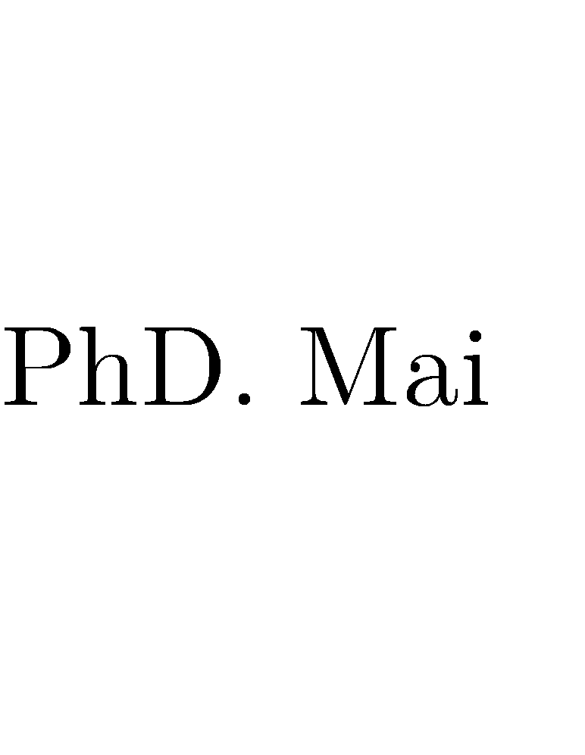







IMAGE-BASED CHARACTER RETRIEVAL FROM MOVIES
Nguyễn Nguyên Khôi – 21521009 Đỗ Minh Khôi - 21521007

Slide 2
Table of Contents
1
Problem re-introduction
2
Methods
03
3
Evaluation
Chapter 6: Vector Semantics and Embeddings | December 05, 2023 | 2

Slide 3
Table of Contents
1. Problem re-introduction
Chapter 6: Vector Semantics and Embeddings | December 05, 2023 | 3

Slide 4
Problem re-introduction
Input:
A database (index) of a movie
A set of query images of a character presented in the given movie
Output:
All shots in which the character appear
Constraint:
Not a cartoon movie
Query images must be cut from movie
Chapter 6: Vector Semantics and Embeddings | December 05, 2023 | 4

Slide 5
Problem re-introduction
Requirements:
The result must cover all true shots, including ones in which the person is not clear (faces are unable to detect, too much illumination, etc.)
As many relevant shots retrieved as possible
Chapter 6: Vector Semantics and Embeddings | December 05, 2023 | 5

Slide 6

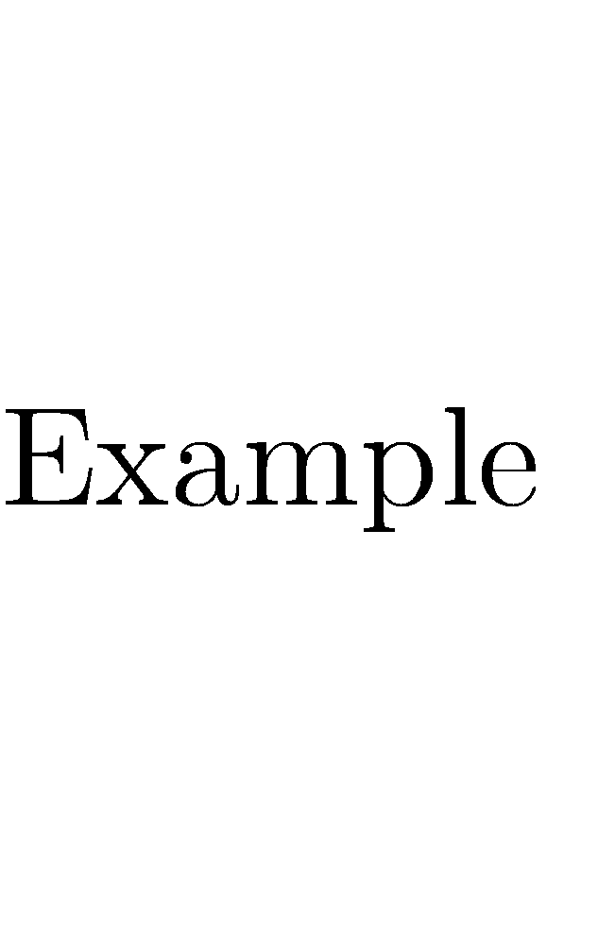
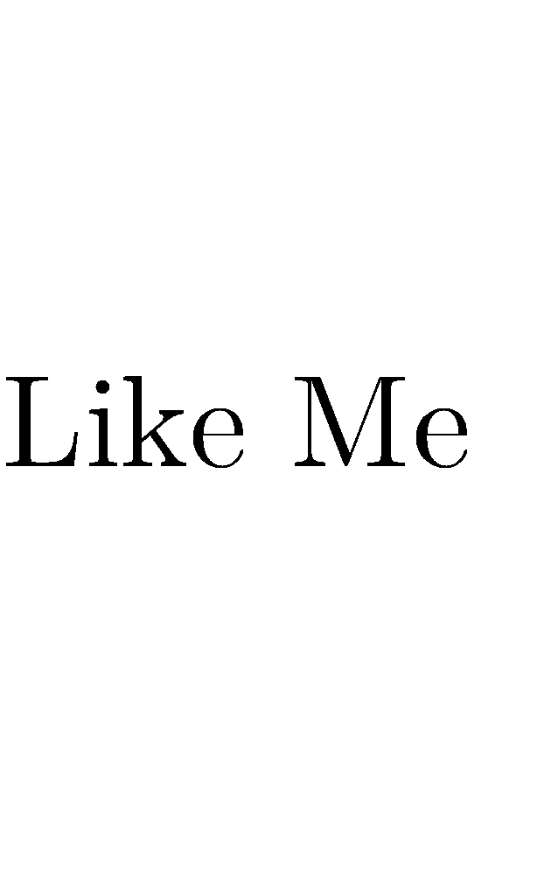





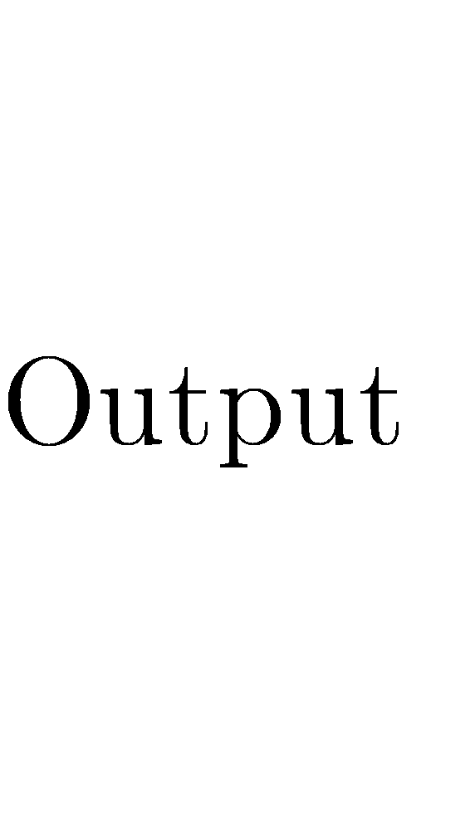





●
●

Slide 7

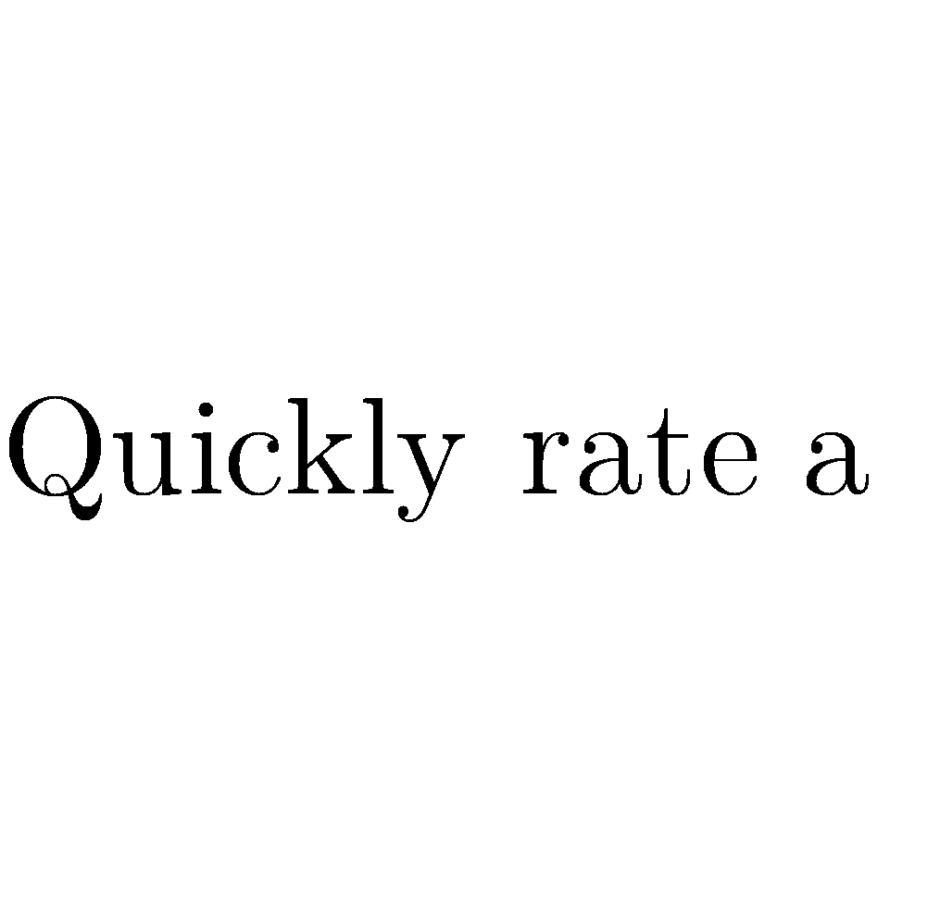
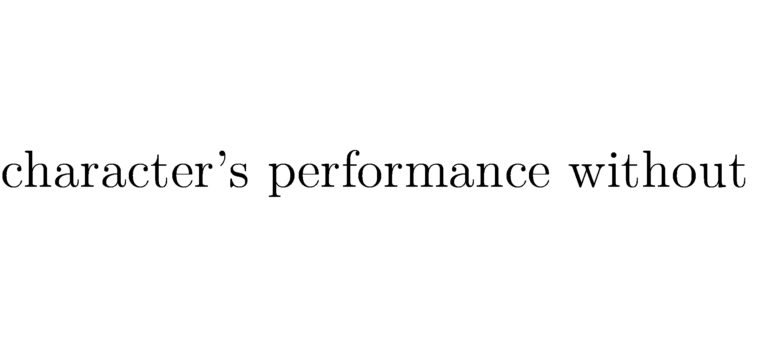
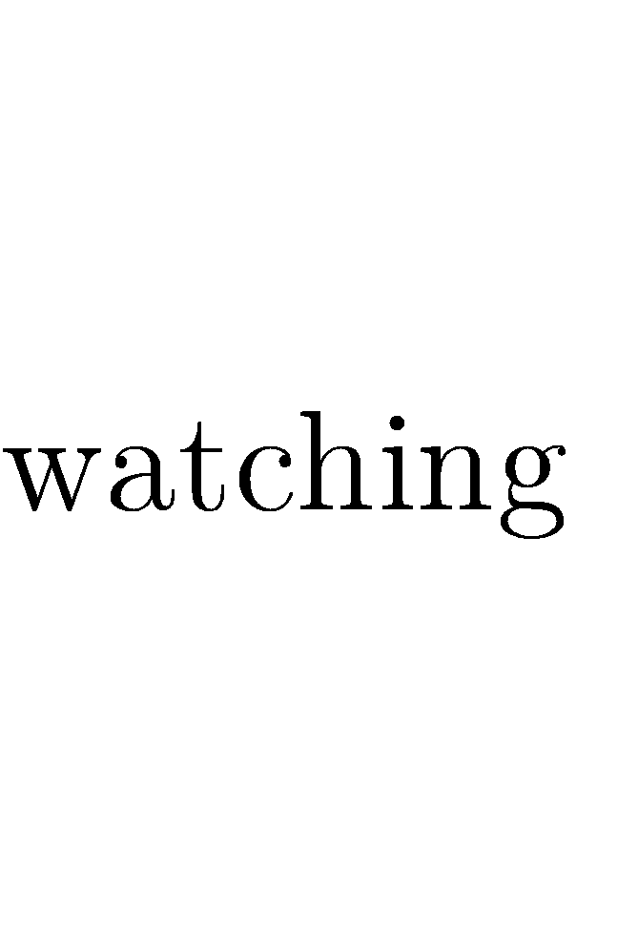
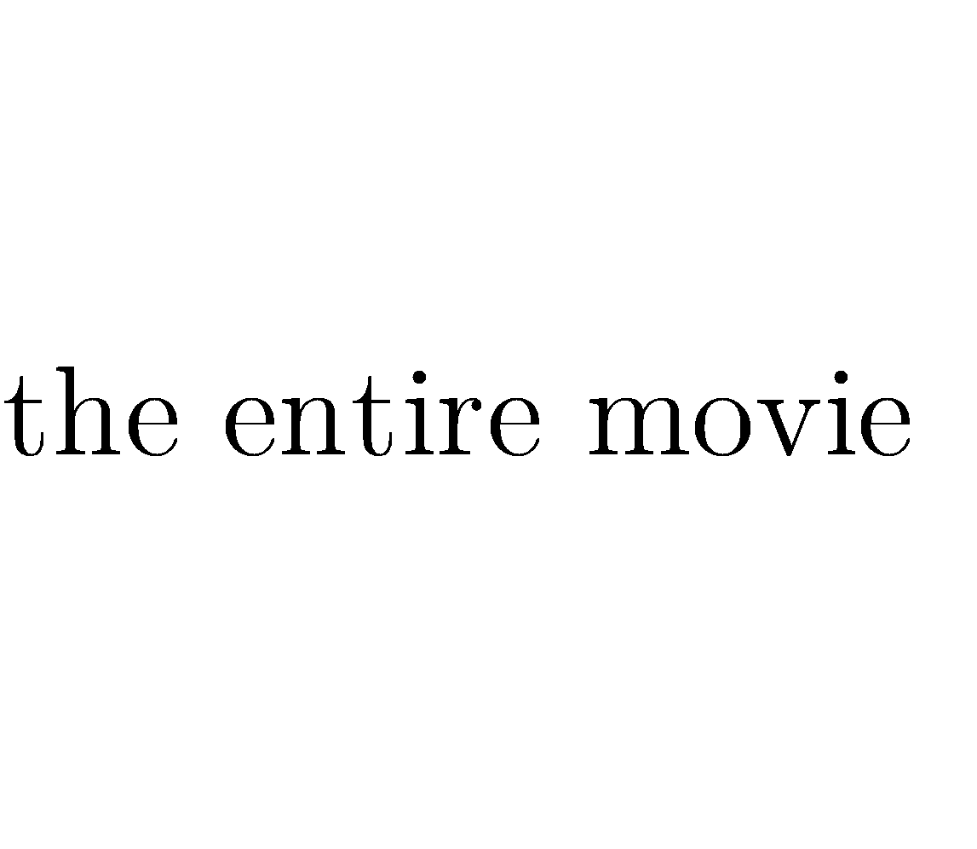
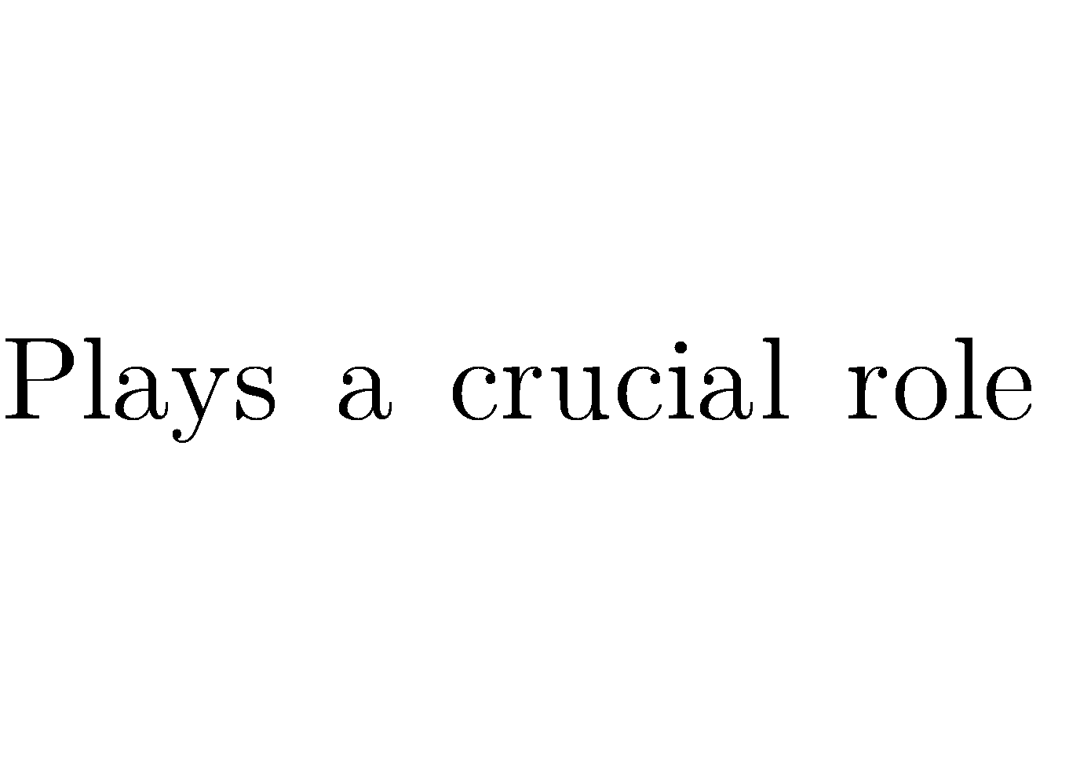
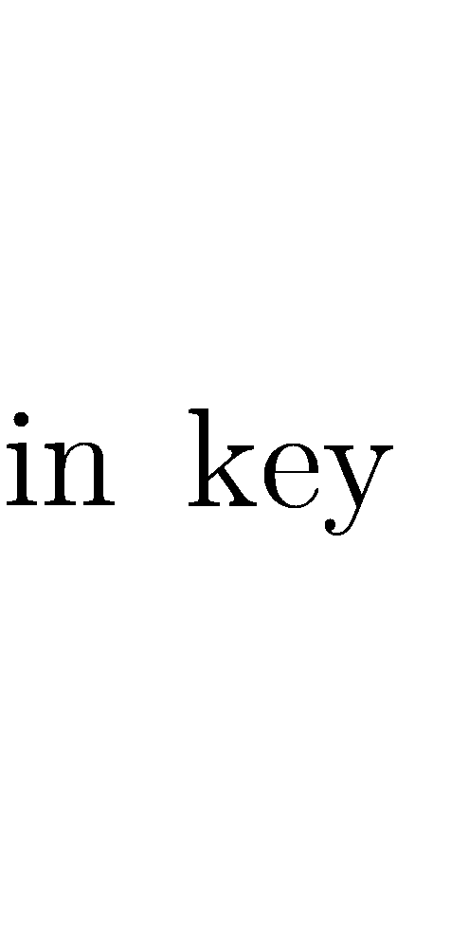

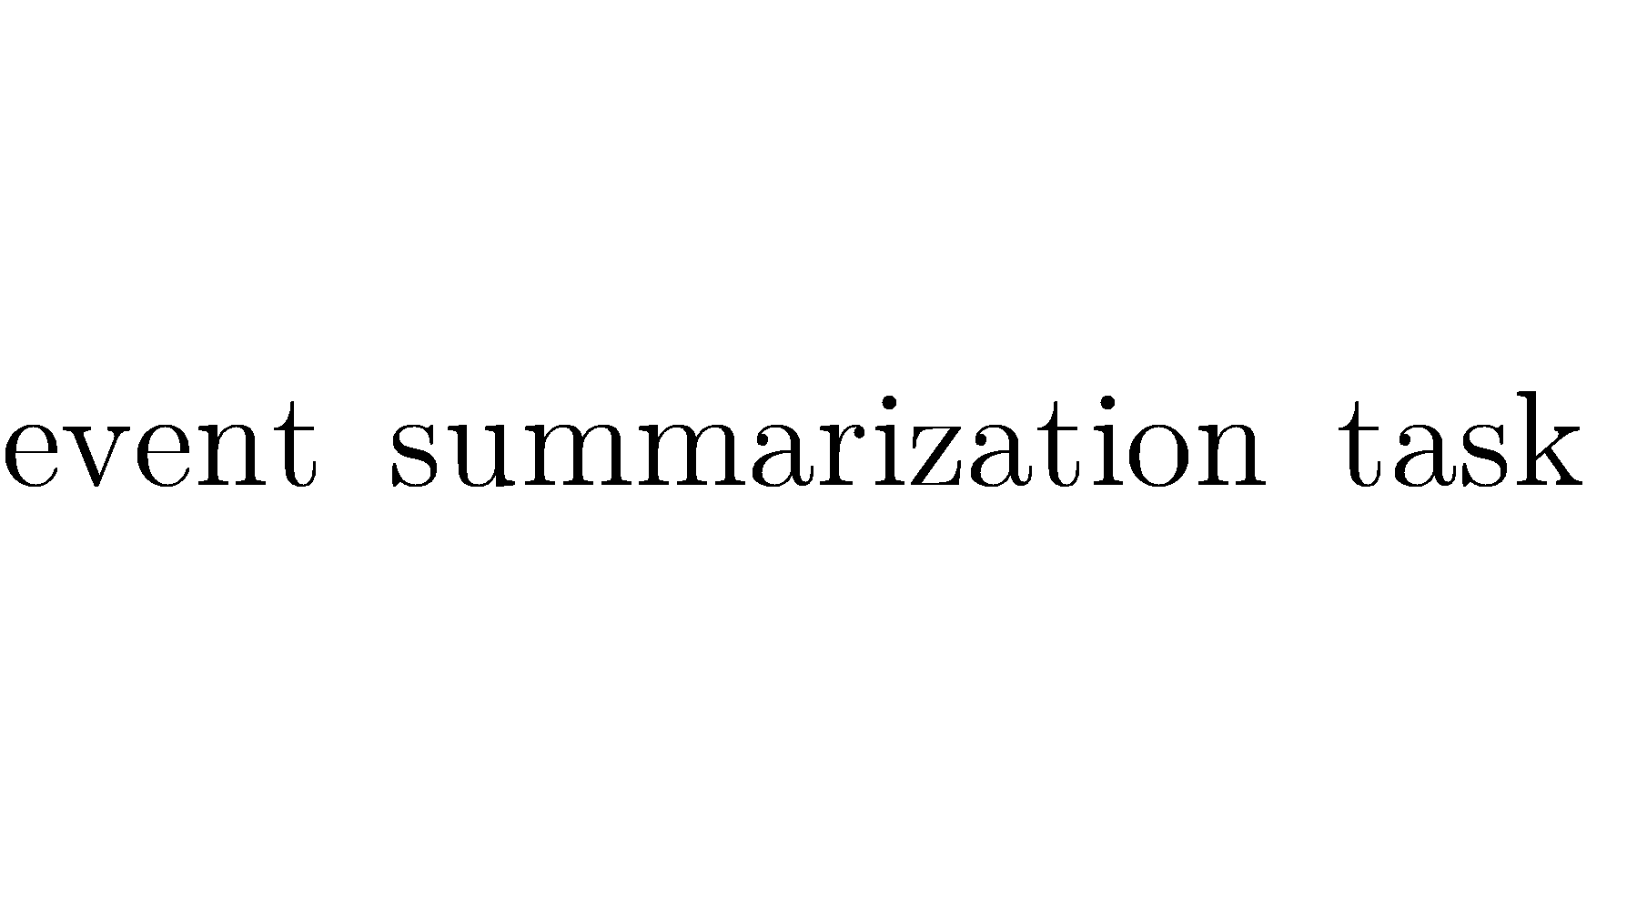
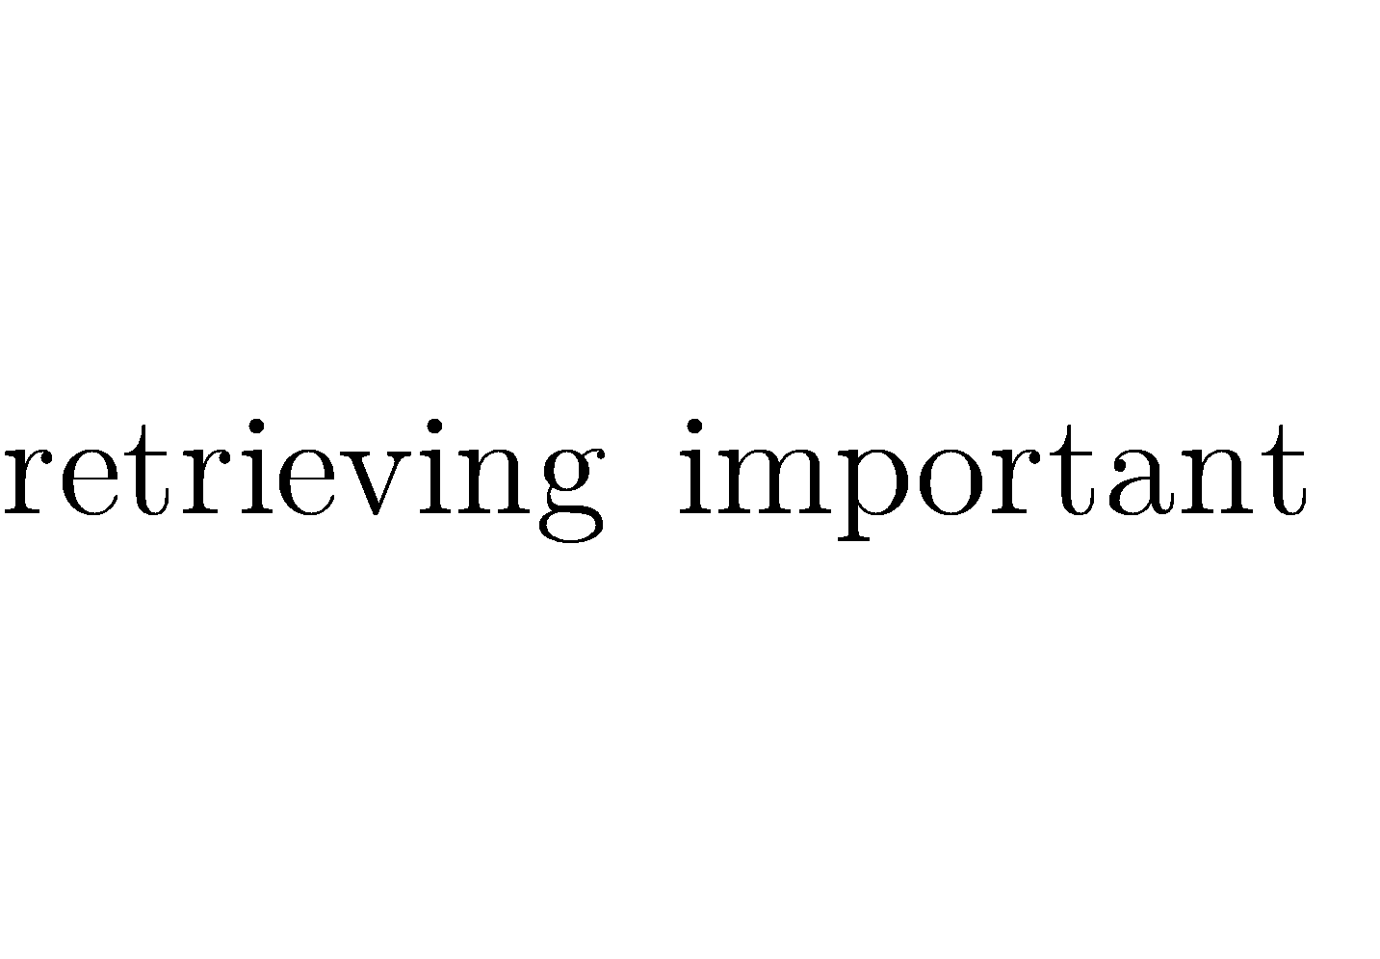
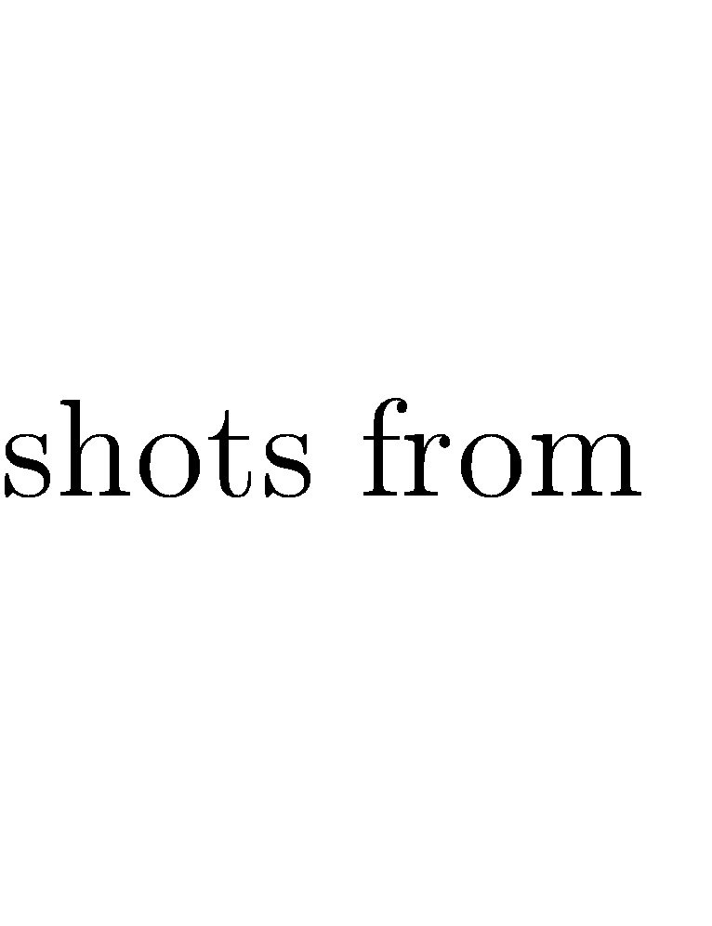



●
●

Slide 8
Table of Contents
2. Methods
Person detection: YOLOv8
Feature extraction:
DINO v2
Facenet, VGGFace
Building index for each movie using FAISS
Chapter 6: Vector Semantics and Embeddings | December 05, 2023 | 8

Slide 9
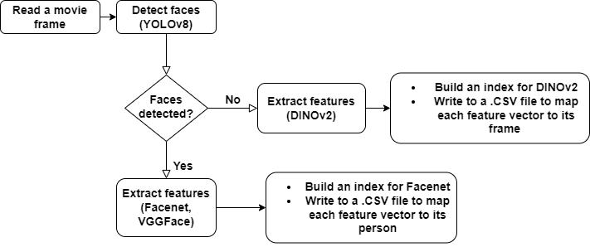
Offline stage
Chapter 6: Vector Semantics and Embeddings | December 05, 2023 | 9

Slide 10
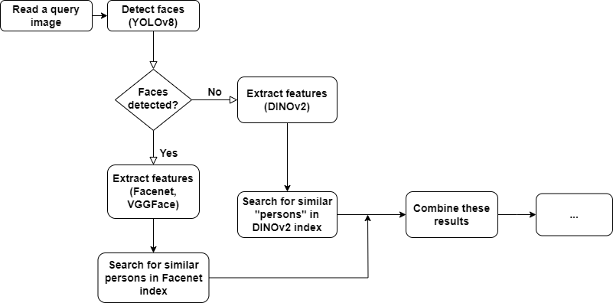
Online stage
Chapter 6: Vector Semantics and Embeddings | December 05, 2023 | 10

Slide 11
Table of Contents
3. Evaluation
Dataset: TRECVID_MSUM_2022
Metrics: precision & recall
(only if all query images are involved in the querying phase)
Chapter 6: Vector Semantics and Embeddings | December 05, 2023 | 11

Slide 12
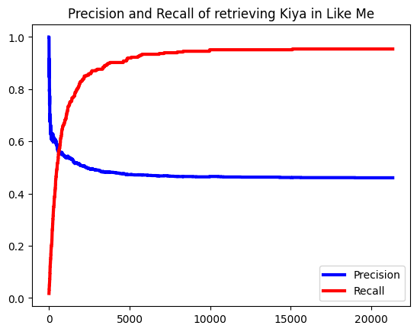
Evaluation
Previous experiment using only DINOv2 for extracting features:
Chapter 6: Vector Semantics and Embeddings | December 05, 2023 | 12

Slide 13
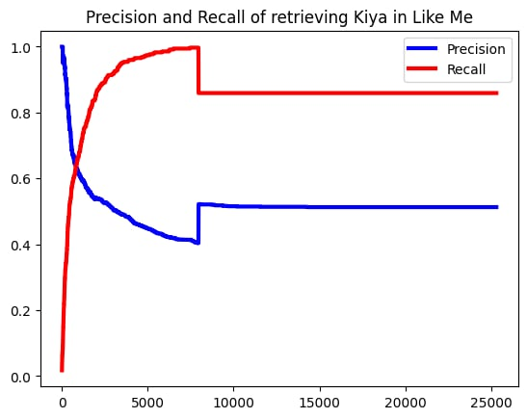

Evaluation
FaceNet + DINOv2
VGGFace + DINOv2
Chapter 6: Vector Semantics and Embeddings | December 05, 2023 | 13

Slide 14
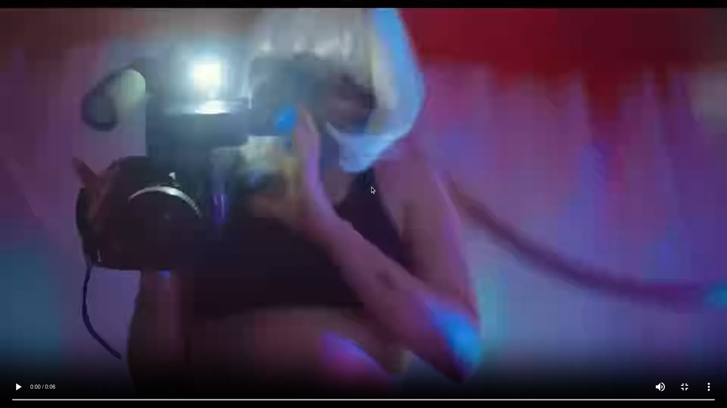
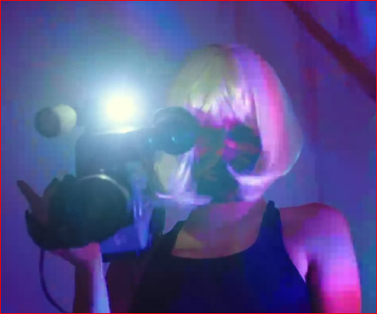
Evaluation
Kiya6.png:
Chapter 6: Vector Semantics and Embeddings | December 05, 2023 | 14

Slide 15
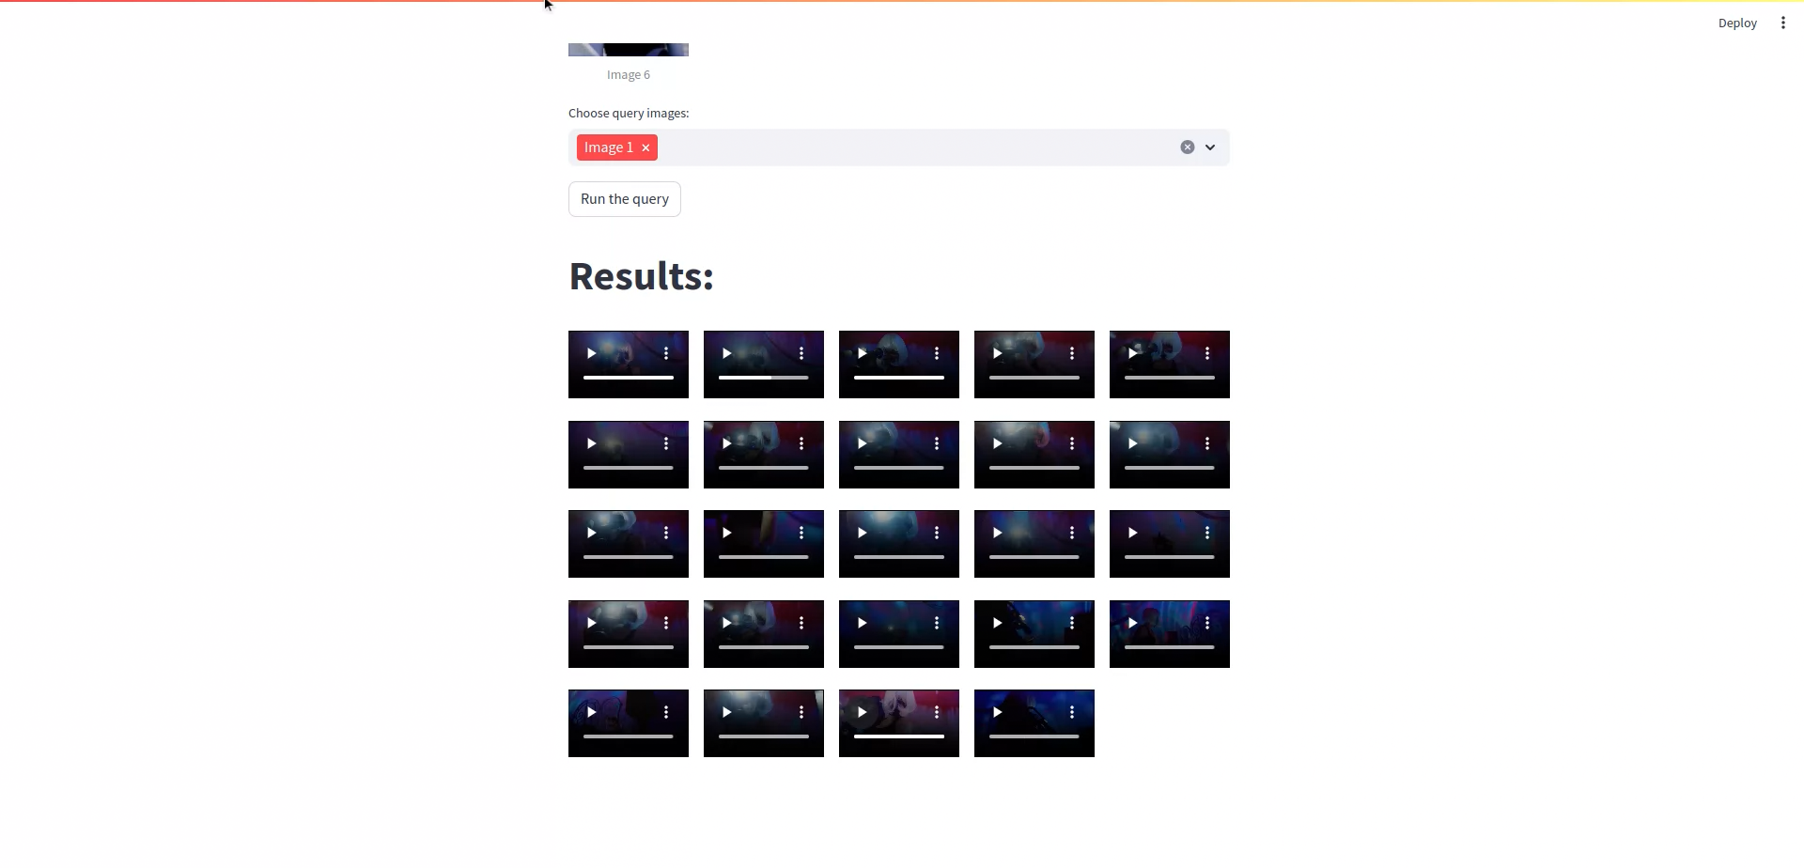
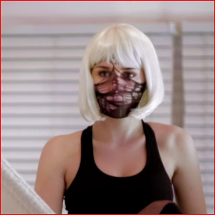
Evaluation
Kiya1.png:
Chapter 6: Vector Semantics and Embeddings | December 05, 2023 | 15

Slide 16
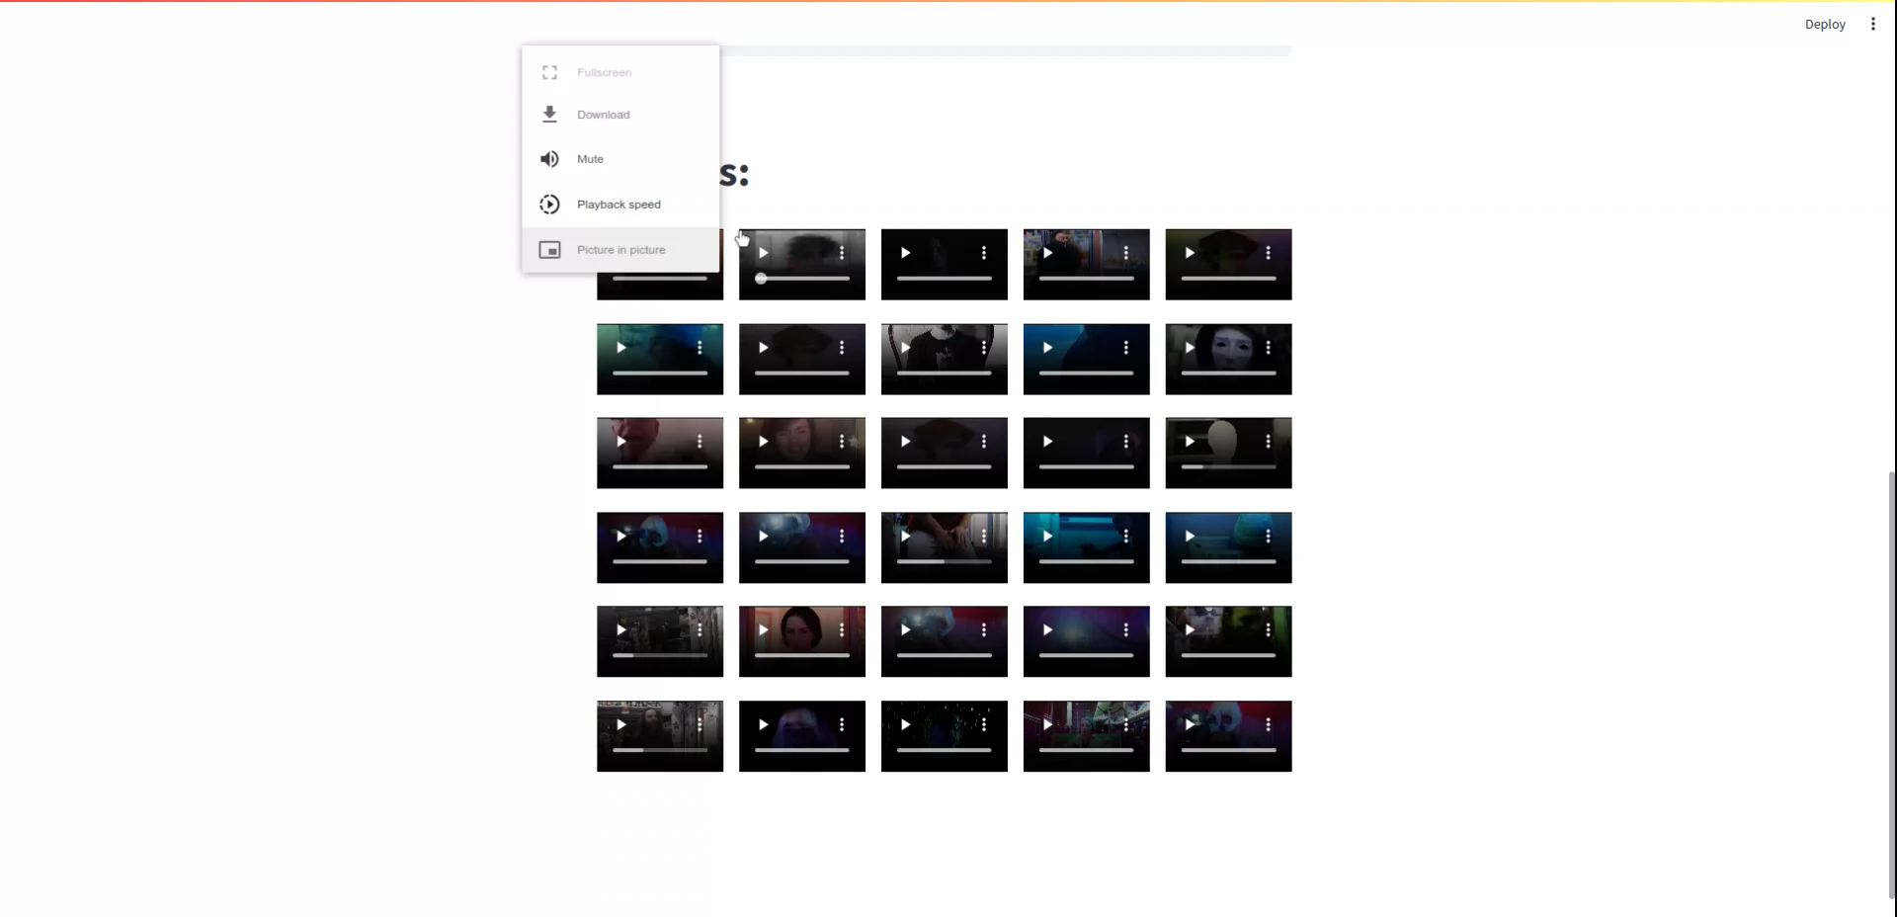
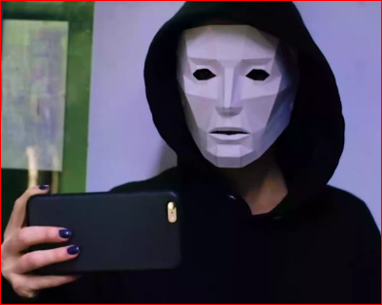
Evaluation
Kiya1.png:
Chapter 6: Vector Semantics and Embeddings | December 05, 2023 | 16

Slide 17

















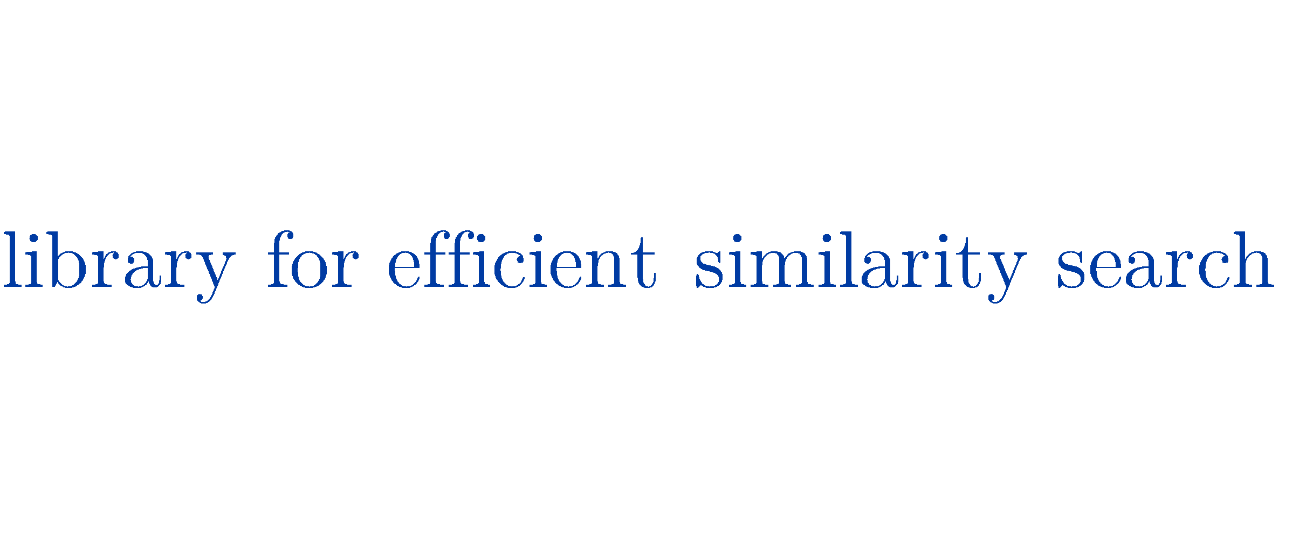


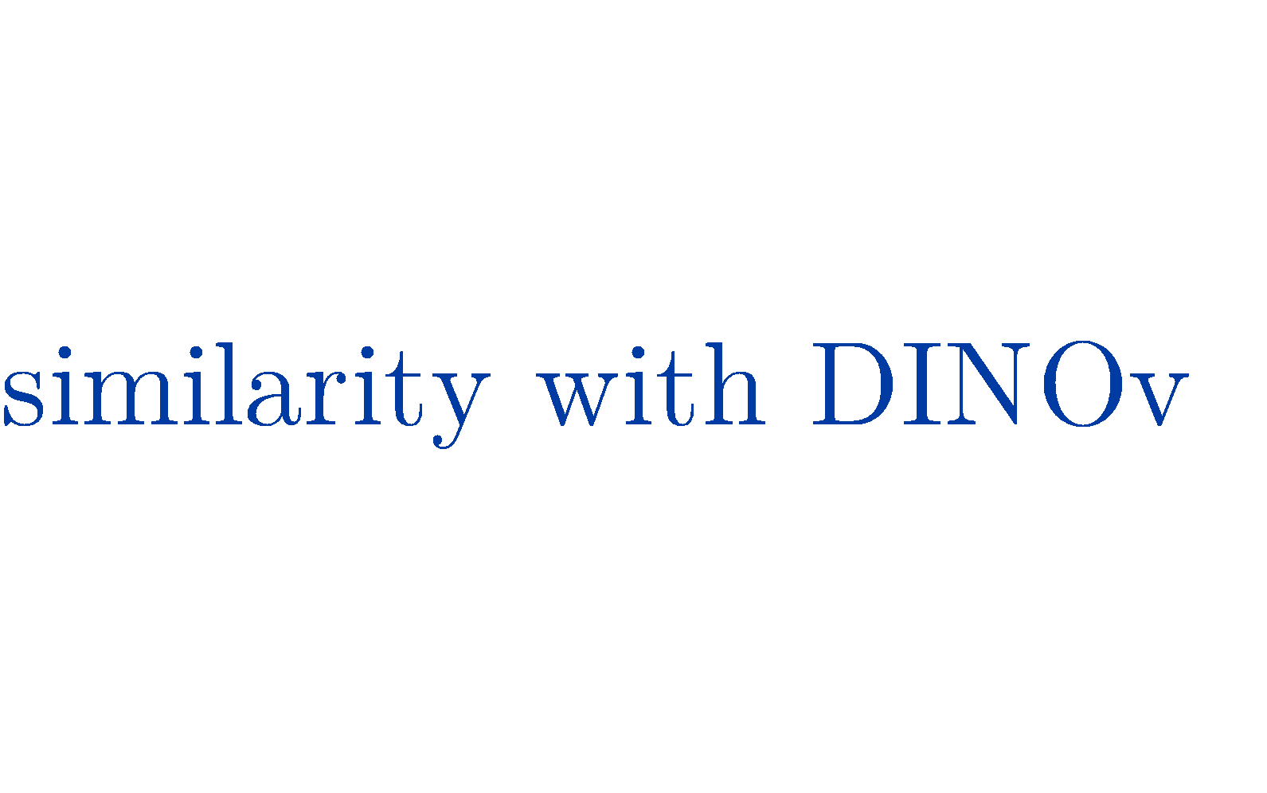


References
17
Chapter 6: Vector Semantics and Embeddings | December 05, 2023 | 25

Slide 18


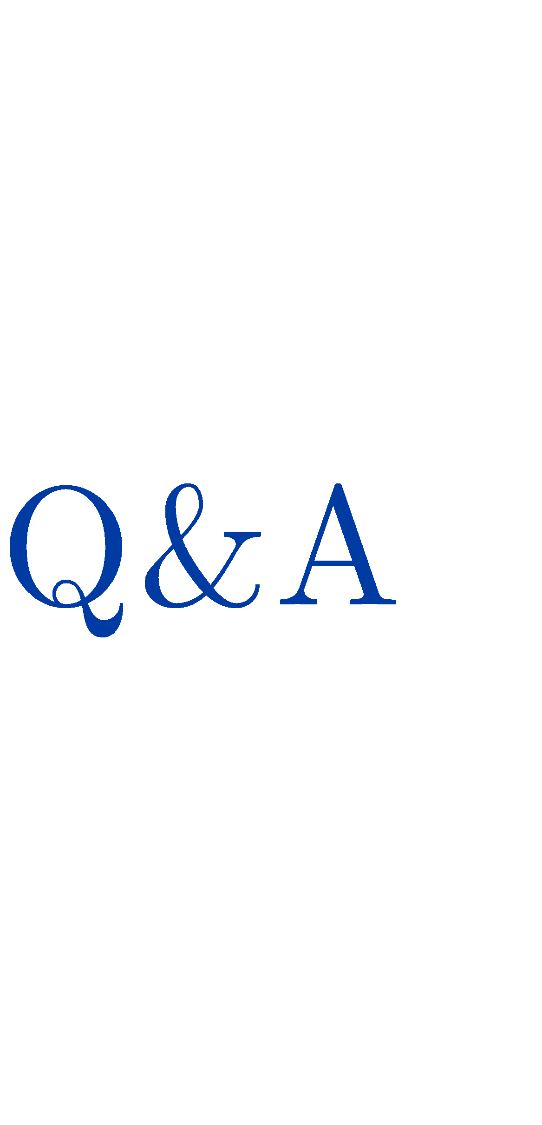
18

